Slide 1


Course Name :Advanced Database System
Course Code:CS4173(Program Elective V)
Unit No : 01
Unit Name :Database System Architectures
Course Teacher: Prof. V.C.Deshmukh
Department of Computer Science & Engineering
Rajarambapu Institute of Technology, Sakharale, INDIA

Slide 2
Chapter 1: Database System Architectures
Lecture-1

Slide 3
Database System Architectures
Centralized and Client-Server Systems
Server System Architectures
Parallel Systems
Distributed Systems
Network Types

Slide 4
Centralized Systems
Run on a single computer system and do not interact with other computer systems
General-purpose computer system
Single-user system (e.g., personal computer or workstation)
Multi-user system (Server systems)

Slide 5
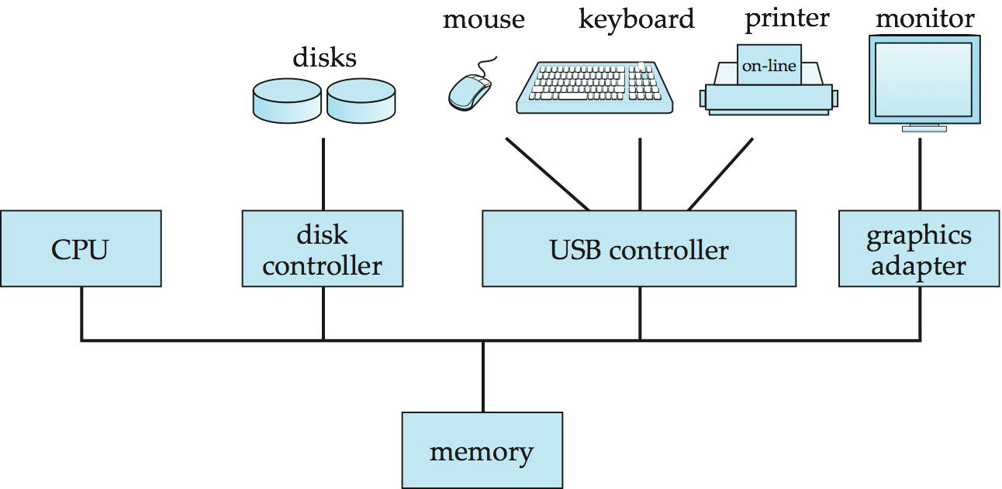
A Centralized Computer System

Slide 6
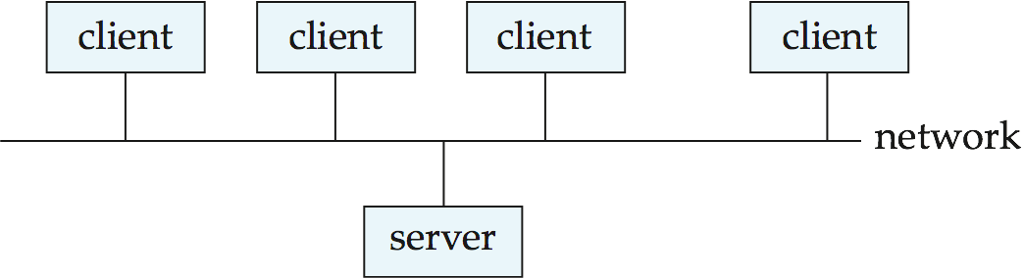
Client-Server Systems
Server systems satisfy requests generated at m client systems, whose general structure is shown below:

Slide 7
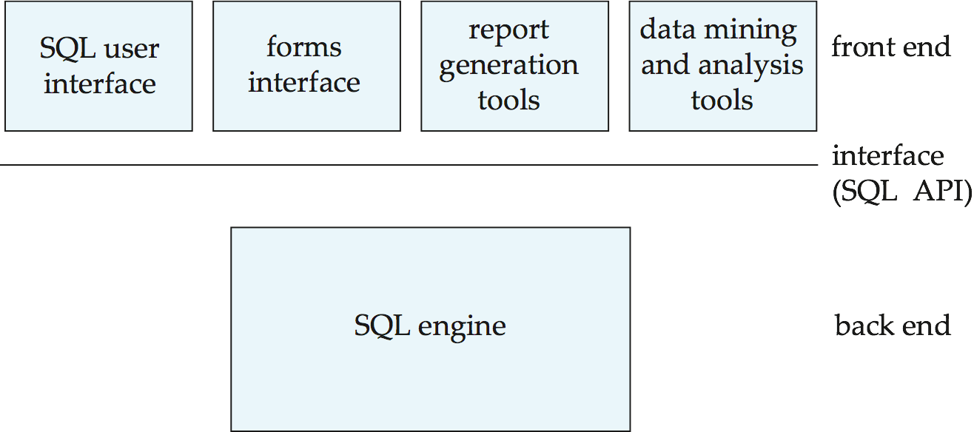
Client-Server Systems (Cont.)
Database functionality can be divided into:
  Back-end: manages access structures, query evaluation and optimization, concurrency control and recovery.
  Front-end: consists of tools such as forms, report-writers, and graphical user interface facilities.
The interface between the front-end and the back-end is through SQL or through an application program interface.

Slide 8
Client-Server Systems (Cont.)
Advantages of replacing mainframes with networks of workstations or personal computers connected to back-end server machines:
  better functionality for the cost
  flexibility in locating resources and expanding facilities
  better user interfaces
  easier maintenance

Slide 9
Server System Architecture
Server systems can be broadly categorized into two kinds:
  Transaction servers which are widely used in relational database systems, and
  Data servers, used in object-oriented database systems

Slide 10
Transaction Servers
Also called query server systems or SQL server systems
  Clients send requests to the server
  Transactions are executed at the server
  Results are shipped back to the client.
Requests are specified in SQL, and communicated to the server through a remote procedure call (RPC) mechanism.
Transactional RPC allows many RPC calls to form a transaction.
Open Database Connectivity (ODBC) is a C language application program interface standard from Microsoft for connecting to a server, sending SQL requests, and receiving results.
JDBC standard is similar to ODBC, for Java

Slide 11
Transaction Server Process Structure
A typical transaction server consists of multiple processes accessing data in shared memory.
Server processes
  These receive user queries (transactions), execute them and send results back
  Processes may be multithreaded, allowing a single process to execute several user queries concurrently
  Typically multiple multithreaded server processes
Lock manager process
  More on this later
Database writer process
  Output modified buffer blocks to disks continually

Slide 12
Transaction Server Processes (Cont.)
Log writer process
  Server processes simply add log records to log record buffer
  Log writer process outputs log records to stable storage.
Checkpoint process
  Performs periodic checkpoints
Process monitor process
  Monitors other processes, and takes recovery actions if any of the other processes fail
    E.g., aborting any transactions being executed by a server process and restarting it

Slide 13
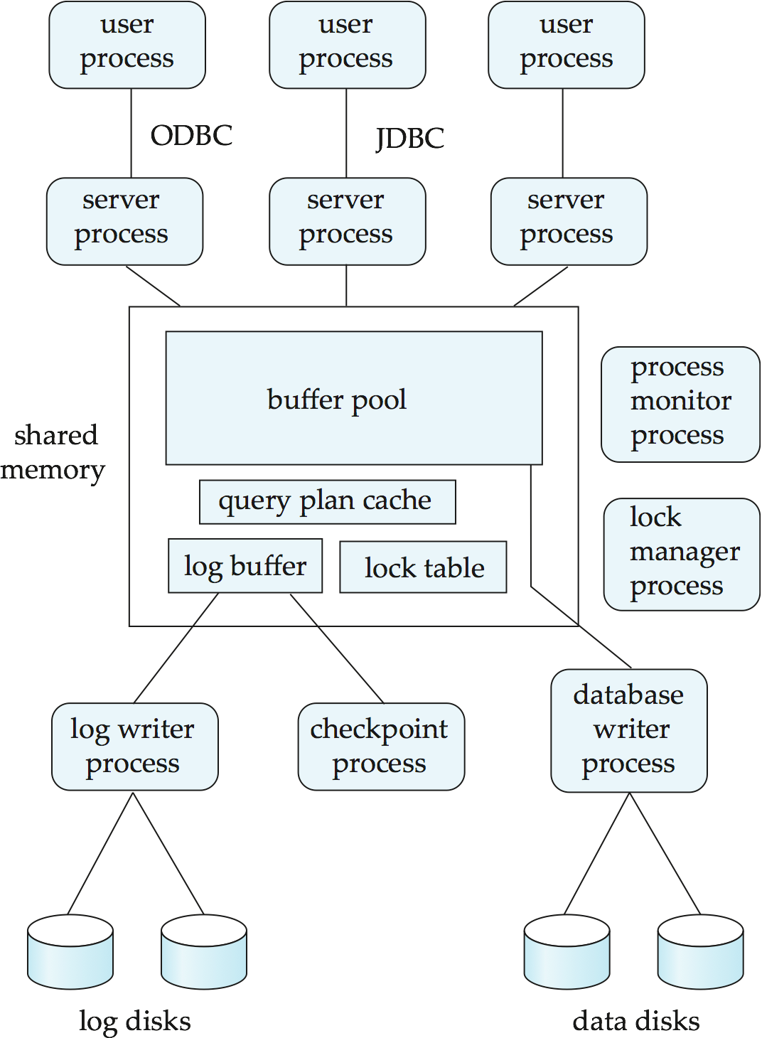
Transaction System Processes (Cont.)

Slide 14
Transaction System Processes (Cont.)
Shared memory contains shared data
  Buffer pool
  Lock table
  Log buffer
  Cached query plans (reused if same query submitted again)
All database processes can access shared memory
To ensure that no two processes are accessing the same data structure at the same time, databases systems implement mutual exclusion using either
  Operating system semaphores
  Atomic instructions such as test-and-set

Slide 15
Data Servers
Used in high-speed LANs, in cases where
  The clients are comparable in processing power to the server
  The tasks to be executed are compute intensive.
Data are shipped to clients where processing is performed, and then shipped results back to the server.
This architecture requires full back-end functionality at the clients.
Used in many object-oriented database systems
Issues:
  Page-Shipping versus Item-Shipping
  Locking
  Data Caching
  Lock Caching

Slide 16
Data Servers (Cont.)
Page-shipping versus item-shipping
  Smaller unit of shipping ⇒ more messages
  Worth prefetching related items along with requested item
  Page shipping can be thought of as a form of prefetching
Locking
  Overhead of requesting and getting locks from server is high due to message delays
  Can grant locks on requested and prefetched items
  With page shipping, transaction is granted lock on whole page.
  Locks on the page can be deescalated to locks on items in the page when there are lock conflicts

Slide 17
Data Servers (Cont.)
Data Caching
  Data can be cached at client even in between transactions
  But check that data is up-to-date before it is used (cache coherency)
  Check can be done when requesting lock on data item
Lock Caching
  Locks can be retained by client system even in between transactions
  Transactions can acquire cached locks locally, without contacting server
  Server calls back locks from clients when it receives conflicting lock request. Client returns lock once no local transaction is using it.

Slide 18
Lecture 2 - Parallel Systems
Parallel database systems consist of multiple processors and multiple disks connected by a fast interconnection network.
A coarse-grain parallel machine consists of a small number of powerful processors
A massively parallel or fine grain parallel machine utilizes thousands of smaller processors.
Two main performance measures:
  throughput --- the number of tasks that can be completed in a given time interval
  response time --- the amount of time it takes to complete a single task from the time it is submitted

Slide 19
Speed-Up and Scale-Up
Speedup: a fixed-sized problem executing on a small system is given to a system which is N-times larger.
  Measured by:
  speedup = small system elapsed time
  large system elapsed time
  Speedup is linear if equation equals N.
Scaleup: increase the size of both the problem and the system
  N-times larger system used to perform N-times larger job
  Measured by:
  scaleup = small system small problem elapsed time
  big system big problem elapsed time
  Scale up is linear if equation equals 1.

Slide 20
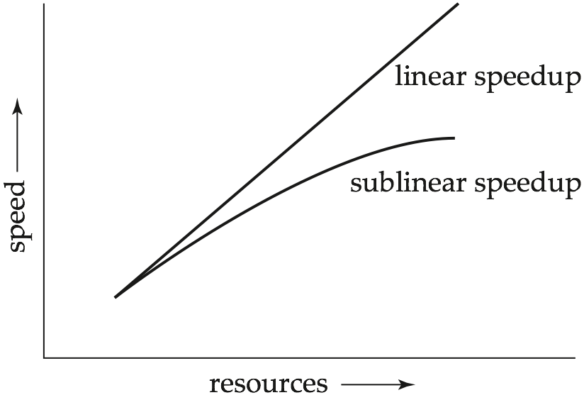
Speedup

Slide 21
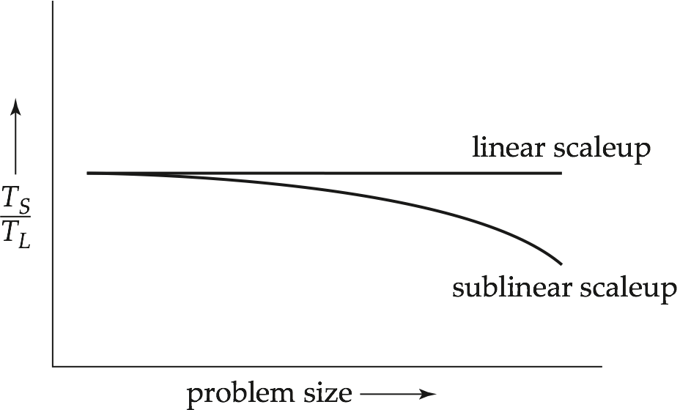
Scaleup

Slide 22
Batch and Transaction Scaleup
Batch scaleup:
  A single large job; typical of most decision support queries and scientific simulation.
  Use an N-times larger computer on N-times larger problem.
Transaction scaleup:
  Numerous small queries submitted by independent users to a shared database; typical transaction processing and timesharing systems.
  N-times as many users submitting requests (hence, N-times as many requests) to an N-times larger database, on an N-times larger computer.
  Well-suited to parallel execution.

Slide 23
Factors Limiting Speedup and Scaleup
Speedup and scaleup are often sublinear due to:
Startup costs: Cost of starting up multiple processes may dominate computation time, if the degree of parallelism is high.
Interference: Processes accessing shared resources (e.g., system bus, disks, or locks) compete with each other, thus spending time waiting on other processes, rather than performing useful work.
Skew: Increasing the degree of parallelism increases the variance in service times of parallely executing tasks. Overall execution time determined by slowest of parallely executing tasks.

Slide 24
Interconnection Network Architectures
Bus. System components send data on and receive data from a single communication bus;
  Does not scale well with increasing parallelism.
Mesh. Components are arranged as nodes in a grid, and each component is connected to all adjacent components
  Communication links grow with growing number of components, and so scales better.
  But may require 2√n hops to send message to a node (or √n with wraparound connections at edge of grid).
Hypercube. Components are numbered in binary; components are connected to one another if their binary representations differ in exactly one bit.
  n components are connected to log(n) other components and can reach each other via at most log(n) links; reduces communication delays.

Slide 25
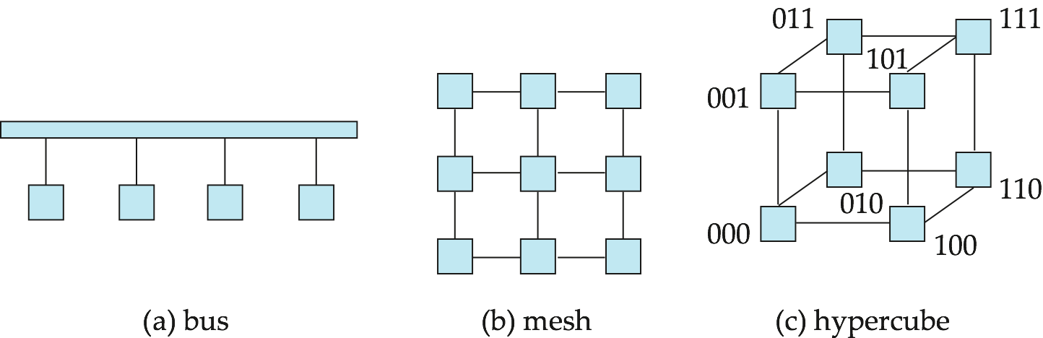
Interconnection Architectures

Slide 26
Parallel Database Architectures
Shared memory -- processors share a common memory
Shared disk -- processors share a common disk
Shared nothing -- processors share neither a common memory nor common disk
Hierarchical -- hybrid of the above architectures

Slide 27
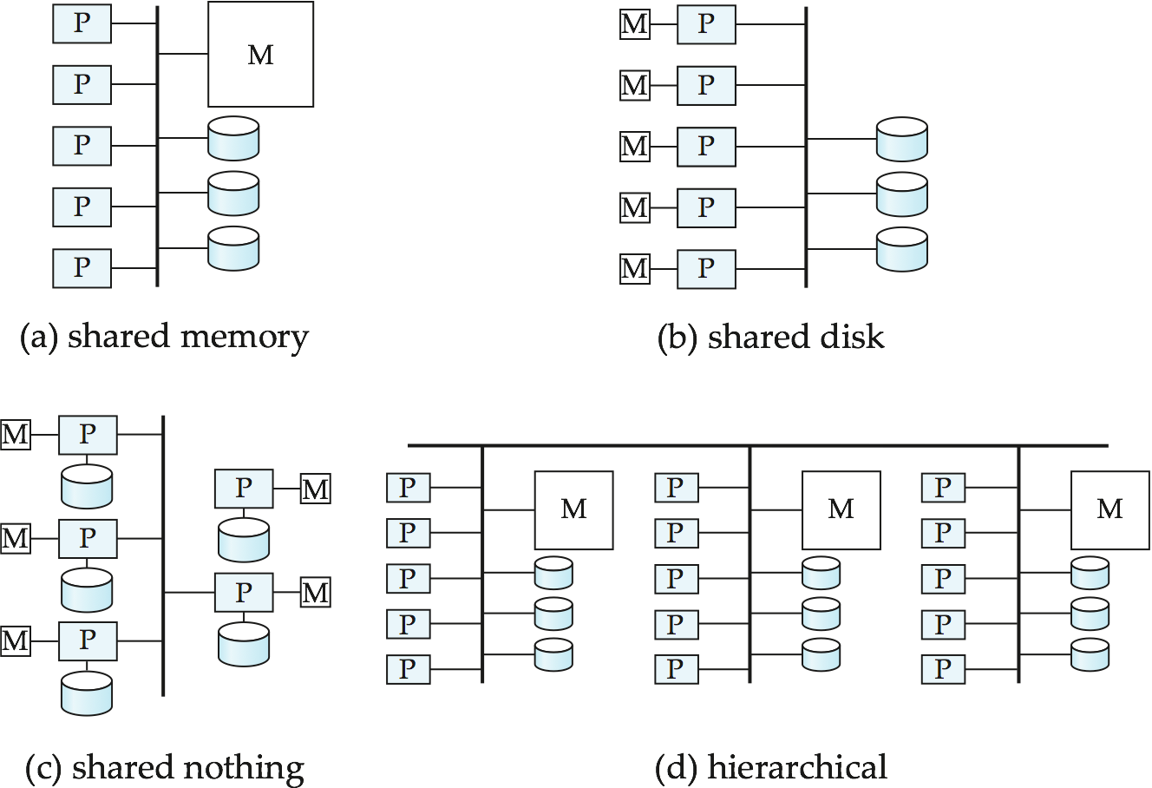
Parallel Database Architectures

Slide 28
Shared Memory
Processors and disks have access to a common memory, typically via a bus or through an interconnection network.
Extremely efficient communication between processors — data in shared memory can be accessed by any processor without having to move it using software.
Downside – architecture is not scalable beyond 32 or 64 processors since the bus or the interconnection network becomes a bottleneck
Widely used for lower degrees of parallelism (4 to 8).

Slide 29
Shared Disk
All processors can directly access all disks via an interconnection network, but the processors have private memories.
  The memory bus is not a bottleneck
  Architecture provides a degree of fault-tolerance — if a processor fails, the other processors can take over its tasks since the database is resident on disks that are accessible from all processors.
Examples: IBM Sysplex and DEC clusters (now part of Compaq) running Rdb (now Oracle Rdb) were early commercial users
Downside: bottleneck now occurs at interconnection to the disk subsystem.
Shared-disk systems can scale to a somewhat larger number of processors, but communication between processors is slower.

Slide 30
Shared Nothing
Node consists of a processor, memory, and one or more disks. Processors at one node communicate with another processor at another node using an interconnection network. A node functions as the server for the data on the disk or disks the node owns.
Examples: Teradata, Tandem, Oracle-n CUBE
Data accessed from local disks (and local memory accesses) do not pass through interconnection network, thereby minimizing the interference of resource sharing.
Shared-nothing multiprocessors can be scaled up to thousands of processors without interference.
Main drawback: cost of communication and non-local disk access; sending data involves software interaction at both ends.

Slide 31
Hierarchical
Combines characteristics of shared-memory, shared-disk, and shared-nothing architectures.
Top level is a shared-nothing architecture – nodes connected by an interconnection network, and do not share disks or memory with each other.
Each node of the system could be a shared-memory system with a few processors.
Alternatively, each node could be a shared-disk system, and each of the systems sharing a set of disks could be a shared-memory system.
Reduce the complexity of programming such systems by distributed virtual-memory architectures
  Also called non-uniform memory architecture (NUMA)

Slide 32
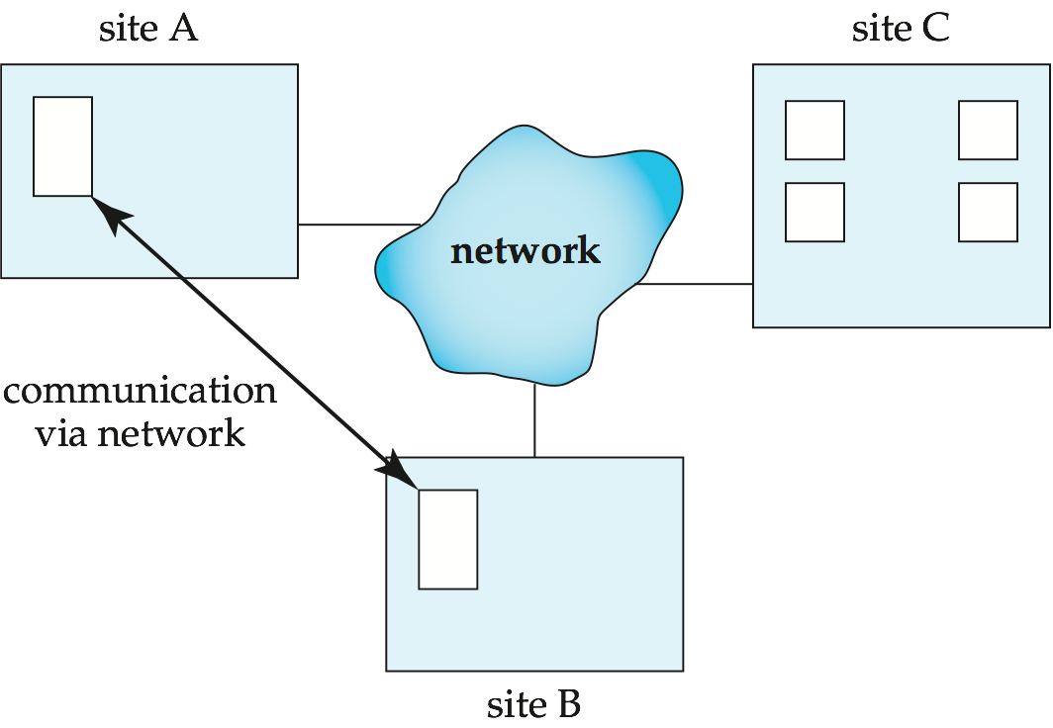
Distributed Systems
Data spread over multiple machines (also referred to as sites or nodes).
Network interconnects the machines
Data shared by users on multiple machines

Slide 33
Distributed Databases
Homogeneous distributed databases
  Same software/schema on all sites, data may be partitioned among sites
  Goal: provide a view of a single database, hiding details of distribution
Heterogeneous distributed databases
  Different software/schema on different sites
  Goal: integrate existing databases to provide useful functionality
Differentiate between local and global transactions
  A local transaction accesses data in the single site at which the transaction was initiated.
  A global transaction either accesses data in a site different from the one at which the transaction was initiated or accesses data in several different sites.

Slide 34
Trade-offs in Distributed Systems
Sharing data – users at one site able to access the data residing at some other sites.
Autonomy – each site is able to retain a degree of control over data stored locally.
Higher system availability through redundancy — data can be replicated at remote sites, and system can function even if a site fails.
Disadvantage: added complexity required to ensure proper coordination among sites.
  Software development cost.
  Greater potential for bugs.
  Increased processing overhead.

Slide 35
Implementation Issues for Distributed Databases
Atomicity needed even for transactions that update data at multiple sites
The two-phase commit protocol (2PC) is used to ensure atomicity
  Basic idea: each site executes transaction until just before commit, and the leaves final decision to a coordinator
  Each site must follow decision of coordinator, even if there is a failure while waiting for coordinators decision
2PC is not always appropriate: other transaction models based on persistent messaging, and workflows, are also used
Distributed concurrency control (and deadlock detection) required
Data items may be replicated to improve data availability

Slide 36
Lecture-3
Distributed Data Storage
Assume relational data model
Replication
  System maintains multiple copies of data, stored in different sites, for faster retrieval and fault tolerance.
Fragmentation
  Relation is partitioned into several fragments stored in distinct sites
Replication and fragmentation can be combined
  Relation is partitioned into several fragments: system maintains several identical replicas of each such fragment.

Slide 37
Data Replication
A relation or fragment of a relation is replicated if it is stored redundantly in two or more sites.
Full replication of a relation is the case where the relation is stored at all sites.
Fully redundant databases are those in which every site contains a copy of the entire database.

Slide 38
Data Replication (Cont.)
Advantages of Replication
  Availability: failure of site containing relation r does not result in unavailability of r is replicas exist.
  Parallelism: queries on r may be processed by several nodes in parallel.
  Reduced data transfer: relation r is available locally at each site containing a replica of r.
Disadvantages of Replication
  Increased cost of updates: each replica of relation r must be updated.
  Increased complexity of concurrency control: concurrent updates to distinct replicas may lead to inconsistent data unless special concurrency control mechanisms are implemented.
    One solution: choose one copy as primary copy and apply concurrency control operations on primary copy

Slide 39
Data Fragmentation
Division of relation r into fragments r₁, r₂, …, r_{n} which contain sufficient information to reconstruct relation r.
Horizontal fragmentation: each tuple of r is assigned to one or more fragments
Vertical fragmentation: the schema for relation r is split into several smaller schemas
  All schemas must contain a common candidate key (or superkey) to ensure lossless join property.
  A special attribute, the tuple-id attribute may be added to each schema to serve as a candidate key.
Advantages of Fragmentation

Slide 40
Horizontal Fragmentation of account Relation
branch_name
account_number
balance
Hillside
Hillside
Hillside
A-305
A-226
A-155
500
336
62
account₁ = σ_{branch_name=“Hillside”} (account )
branch_name
account_number
balance
Valleyview
Valleyview
Valleyview
Valleyview
A-177
A-402
A-408
A-639
205
10000
1123
750
account₂ = σ_{branch_name=“Valleyview”} (account )

Slide 41
Vertical Fragmentation of employee_info Relation
branch_name
customer_name
tuple_id
Hillside
Hillside
Valleyview
Valleyview
Hillside
Valleyview
Valleyview
Lowman
Camp
Camp
Kahn
Kahn
Kahn
Green
1
2
3
4
5
6
7
deposit₁ = Πbranch_name, customer_name, tuple_id (employee_info )
account_number
balance
tuple_id
A-305
A-226
A-177
A-402
A-155
A-408
A-639
500
336
205
10000
62
1123
750
1
2
3
4
5
6
7
deposit₂ = Πaccount_number, balance, tuple_id (employee_info )

Slide 42
Data Transparency
Data transparency: Degree to which system user may remain unaware of the details of how and where the data items are stored in a distributed system
Consider transparency issues in relation to:
  Fragmentation transparency
  Replication transparency
  Location transparency

Slide 43
Naming of Data Items - Criteria
1. Every data item must have a system-wide unique name.
2. It should be possible to find the location of data items efficiently.
3. It should be possible to change the location of data items transparently.
4. Each site should be able to create new data items autonomously.

Slide 44
Centralized Scheme - Name Server
Structure:
  name server assigns all names
  each site maintains a record of local data items
  sites ask name server to locate non-local data items
Advantages:
  satisfies naming criteria 1-3
Disadvantages:
  does not satisfy naming criterion 4
  name server is a potential performance bottleneck
  name server is a single point of failure

Slide 45
Use of Aliases
Alternative to centralized scheme: each site prefixes its own site identifier to any name that it generates i.e., site 17.account.
  Fulfills having a unique identifier, and avoids problems associated with central control.
  However, fails to achieve network transparency.
Solution: Create a set of aliases for data items; Store the mapping of aliases to the real names at each site.
The user can be unaware of the physical location of a data item, and is unaffected if the data item is moved from one site to another.

Slide 46
Lecture-4
Distributed Transactions and 2 Phase Commit

Slide 47


Slide 48
Distributed Transactions
Transaction may access data at several sites.
Each site has a local transaction manager responsible for:
  Maintaining a log for recovery purposes
  Participating in coordinating the concurrent execution of the transactions executing at that site.
Each site has a transaction coordinator, which is responsible for:
  Starting the execution of transactions that originate at the site.
  Distributing subtransactions at appropriate sites for execution.
  Coordinating the termination of each transaction that originates at the site, which may result in the transaction being committed at all sites or aborted at all sites.

Slide 49
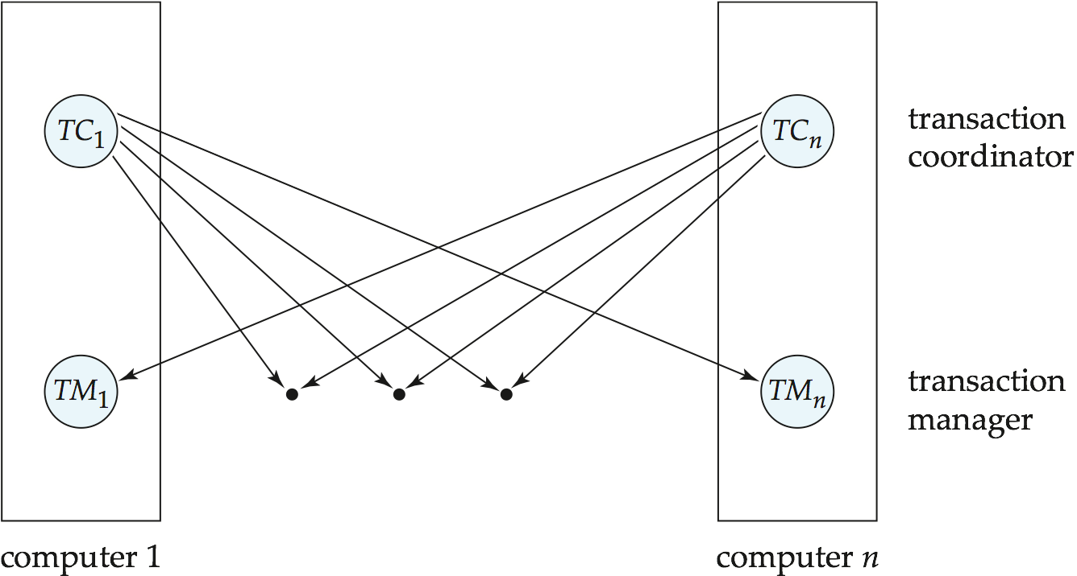
Transaction System Architecture

Slide 50
System Failure Modes
Failures unique to distributed systems:
  Failure of a site.
  Loss of messages
    Handled by network transmission control protocols such as TCP-IP
  Failure of a communication link
    Handled by network protocols, by routing messages via alternative links
  Network partition
    A network is said to be partitioned when it has been split into two or more subsystems that lack any connection between them
      Note: a subsystem may consist of a single node
Network partitioning and site failures are generally indistinguishable.

Slide 51
Commit Protocols
Commit protocols are used to ensure atomicity across sites
  a transaction which executes at multiple sites must either be committed at all the sites, or aborted at all the sites.
  not acceptable to have a transaction committed at one site and aborted at another
The two-phase commit (2PC) protocol is widely used
The three-phase commit (3PC) protocol is more complicated and more expensive, but avoids some drawbacks of two-phase commit protocol. This protocol is not used in practice.

Slide 52
Two Phase Commit Protocol (2PC)
Assumes fail-stop model – failed sites simply stop working, and do not cause any other harm, such as sending incorrect messages to other sites.
Execution of the protocol is initiated by the coordinator after the last step of the transaction has been reached.
The protocol involves all the local sites at which the transaction executed
Let T be a transaction initiated at site S_{i}, and let the transaction coordinator at S_{i} be C_{i}

Slide 53
Phase 1: Obtaining a Decision
Coordinator asks all participants to prepare to commit transaction T_{i}.
  C_{i} adds the records <prepare T> to the log and forces log to stable storage
  sends prepare T messages to all sites at which T executed
Upon receiving message, transaction manager at site determines if it can commit the transaction
  if not, add a record <no T> to the log and send abort T message to C_{i}
  if the transaction can be committed, then:
    add the record <ready T> to the log
  force all records for T to stable storage
    send ready T message to C_{i}

Slide 54
Phase 2: Recording the Decision
T can be committed of C_{i} received a ready T message from all the participating sites: otherwise T must be aborted.
Coordinator adds a decision record, <commit T> or <abort T>, to the log and forces record onto stable storage. Once the record stable storage it is irrevocable (even if failures occur)
Coordinator sends a message to each participant informing it of the decision (commit or abort)
Participants take appropriate action locally.

Slide 55
Handling of Failures - Site Failure
When site S_{i} recovers, it examines its log to determine the fate of transactions active at the time of the failure.
Log contain <commit T> record: txn had completed, nothing to be done
Log contains <abort T> record: txn had completed, nothing to be done
Log contains <ready T> record: site must consult C_{i} to determine the fate of T.
  If T committed, redo (T); write <commit T> record
  If T aborted, undo (T)
The log contains no log records concerning T:
  Implies that S_{k} failed before responding to the prepare T message from C_{i}
  since the failure of S_{k} precludes the sending of such a response, coordinator C₁ must abort T
  S_{k} must execute undo (T)

Slide 56
Handling of Failures- Coordinator Failure
If coordinator fails while the commit protocol for T is executing then participating sites must decide on T’s fate:
  If an active site contains a <commit T> record in its log, then T must be committed.
  If an active site contains an <abort T> record in its log, then T must be aborted.
  If some active participating site does not contain a <ready T> record in its log, then the failed coordinator C_{i} cannot have decided to commit T.
    Can therefore abort T; however, such a site must reject any subsequent <prepare T> message from C_{i}
  If none of the above cases holds, then all active sites must have a <ready T> record in their logs, but no additional control records (such as <abort T> of <commit T>).
    In this case active sites must wait for C_{i} to recover, to find decision.
Blocking problem: active sites may have to wait for failed coordinator to recover.

Slide 57
Handling of Failures - Network Partition
If the coordinator and all its participants remain in one partition, the failure has no effect on the commit protocol.
If the coordinator and its participants belong to several partitions:
  Sites that are not in the partition containing the coordinator think the coordinator has failed, and execute the protocol to deal with failure of the coordinator.
    No harm results, but sites may still have to wait for decision from coordinator.
The coordinator and the sites are in the same partition as the coordinator think that the sites in the other partition have failed, and follow the usual commit protocol.
    Again, no harm results

Slide 58
Recovery and Concurrency Control
In-doubt transactions have a <ready T>, but neither a
<commit T>, nor an <abort T> log record.
The recovering site must determine the commit-abort status of such transactions by contacting other sites; this can slow and potentially block recovery.
Recovery algorithms can note lock information in the log.
  Instead of <ready T>, write out <ready T, L> L = list of locks held by T when the log is written (read locks can be omitted).
  For every in-doubt transaction T, all the locks noted in the
  <ready T, L> log record are reacquired.
After lock reacquisition, transaction processing can resume; the commit or rollback of in-doubt transactions is performed concurrently with the execution of new transactions.

Slide 59
Three Phase Commit (3PC)
Assumptions:
  No network partitioning
  At any point, at least one site must be up.
  At most K sites (participants as well as coordinator) can fail
Phase 1: Obtaining Preliminary Decision: Identical to 2PC Phase 1.
  Every site is ready to commit if instructed to do so
Phase 2 of 2PC is split into 2 phases, Phase 2 and Phase 3 of 3PC
  In phase 2 coordinator makes a decision as in 2PC (called the pre-commit decision) and records it in multiple (at least K) sites
  In phase 3, coordinator sends commit/abort message to all participating sites,
Under 3PC, knowledge of pre-commit decision can be used to commit despite coordinator failure
  Avoids blocking problem as long as < K sites fail
Drawbacks:
  higher overheads
  assumptions may not be satisfied in practice

Slide 60
Alternative Models of Transaction Processing
Notion of a single transaction spanning multiple sites is inappropriate for many applications
  E.g. transaction crossing an organizational boundary
  No organization would like to permit an externally initiated transaction to block local transactions for an indeterminate period
Alternative models carry out transactions by sending messages
  Code to handle messages must be carefully designed to ensure atomicity and durability properties for updates
    Isolation cannot be guaranteed, in that intermediate stages are visible, but code must ensure no inconsistent states result due to concurrency

Slide 61
Alternative Models (Cont.)
Motivating example: funds transfer between two banks
  Two phase commit would have the potential to block updates on the accounts involved in funds transfer
  Alternative solution:
    Debit money from source account and send a message to other site
    Site receives message and credits destination account
  Messaging has long been used for distributed transactions (even before computers were invented!)
Atomicity issue
  once transaction sending a message is committed, message must guaranteed to be delivered
    Guarantee as long as destination site is up and reachable, code to handle undeliverable messages must also be available
      e.g. credit money back to source account.
  If sending transaction aborts, message must not be sent

Slide 62
Lecture-5
Concurrency Control

Slide 63
Concurrency Control
Modify concurrency control schemes for use in distributed environment.
We assume that each site participates in the execution of a commit protocol to ensure global transaction atomicity.
We assume all replicas of any item are updated

Slide 64
Single-Lock-Manager Approach
System maintains a single lock manager that resides in a single chosen site, say S_{i}
When a transaction needs to lock a data item, it sends a lock request to S_{i} and lock manager determines whether the lock can be granted immediately
  If yes, lock manager sends a message to the site which initiated the request
  If no, request is delayed until it can be granted, at which time a message is sent to the initiating site

Slide 65
Single-Lock-Manager Approach
The transaction can read the data item from any one of the sites at which a replica of the data item resides.
Writes must be performed on all replicas of a data item
Advantages of scheme:
  Simple implementation
  Simple deadlock handling
Disadvantages of scheme are:
  Bottleneck: lock manager site becomes a bottleneck
  Vulnerability: system is vulnerable to lock manager site failure.

Slide 66
Distributed Lock Manager
In this approach, functionality of locking is implemented by lock managers at each site
  Lock managers control access to local data items
Advantage: work is distributed and can be made robust to failures
Disadvantage: deadlock detection is more complicated
  Lock managers cooperate for deadlock detection
Several variants of this approach
  Primary copy
  Majority protocol
  Biased protocol
  Quorum consensus

Slide 67
Primary Copy
Choose one replica of data item to be the primary copy.
  Site containing the replica is called the primary site for that data item
  Different data items can have different primary sites
When a transaction needs to lock a data item Q, it requests a lock at the primary site of Q.
  Implicitly gets lock on all replicas of the data item
Benefit
  Concurrency control for replicated data handled similarly to unreplicated data - simple implementation.
Drawback
  If the primary site of Q fails, Q is inaccessible even though other sites containing a replica may be accessible.

Slide 68
Majority Protocol
Local lock manager at each site administers lock and unlock requests for data items stored at that site.
When a transaction wishes to lock an unreplicated data item Q residing at site S_{i}, a message is sent to S_{i} ‘s lock manager.
  If Q is locked in an incompatible mode, then the request is delayed until it can be granted.
  When the lock request can be granted, the lock manager sends a message back to the initiator indicating that the lock request has been granted.

Slide 69
Majority Protocol (Cont.)
In case of replicated data
  If Q is replicated at n sites, then a lock request message must be sent to more than half of the n sites in which Q is stored.
  The transaction does not operate on Q until it has obtained a lock on a majority of the replicas of Q.
  When writing the data item, transaction performs writes on all replicas.
Benefit
  Can be used even when some sites are unavailable
    details on how handle writes in the presence of site failure later
Drawback
  Requires 2(n/2 + 1) messages for handling lock requests, and (n/2 + 1) messages for handling unlock requests.
  Potential for deadlock even with single item - e.g., each of 3 transactions may have locks on 1/3rd of the replicas of a data.

Slide 70
Biased Protocol
Local lock manager at each site as in majority protocol, however, requests for shared locks are handled differently than requests for exclusive locks.
Shared locks. When a transaction needs to lock data item Q, it simply requests a lock on Q from the lock manager at one site containing a replica of Q.
Exclusive locks. When transaction needs to lock data item Q, it requests a lock on Q from the lock manager at all sites containing a replica of Q.
Advantage - imposes less overhead on read operations.
Disadvantage - additional overhead on writes

Slide 71
Quorum Consensus Protocol
A generalization of both majority and biased protocols
Each site is assigned a weight.
  Let S be the total of all site weights
Choose two values read quorum Q_{r} and write quorum Q_{w}
  Such that Q_{r} + Q_{w} > S and 2 * Q_{w} > S
  Quorums can be chosen (and S computed) separately for each item
Each read must lock enough replicas that the sum of the site weights is >= Q_{r}
Each write must lock enough replicas that the sum of the site weights is >= Q_{w}

Slide 72
Deadlock Handling
Consider the following two transactions and history, with item X and transaction T₁ at site 1, and item Y and transaction T₂ at site 2:
T₁: write (X)
write (Y)
T₂: write (Y)
write (X)
X-lock on X
write (X)
X-lock on Y
write (Y)
wait for X-lock on X
Wait for X-lock on Y
Result: deadlock which cannot be detected locally at either site

Slide 73
Centralized Approach
A global wait-for graph is constructed and maintained in a single site; the deadlock-detection coordinator
Global wait-for graph can be constructed when:
  a new edge is inserted in or removed from one of the local wait-for graphs.
  a number of changes have occurred in a local wait-for graph.
  the coordinator needs to invoke cycle-detection.
If the coordinator finds a cycle, it selects a victim and notifies all sites. The sites roll back the victim transaction.

Slide 74
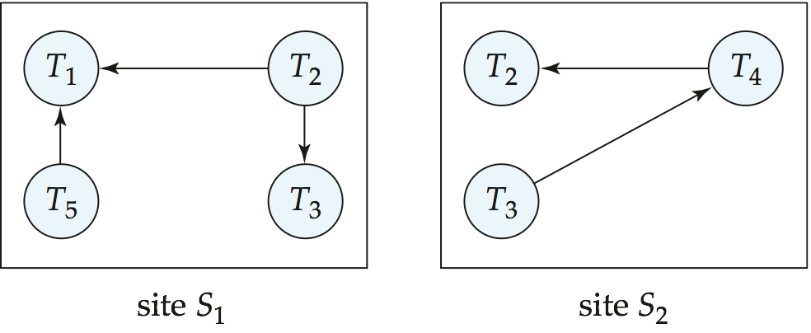
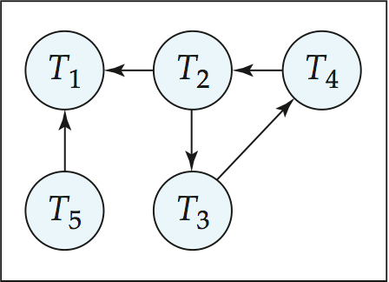
Local and Global Wait-For Graphs
Local
Global

Slide 75
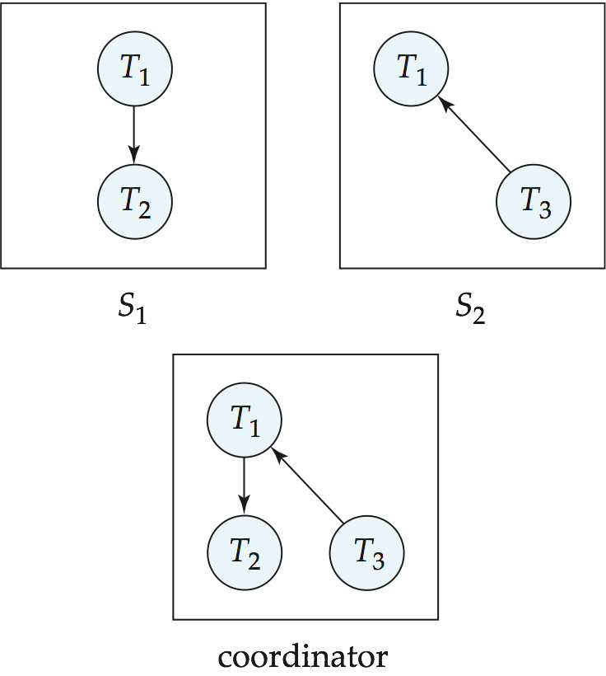
Example Wait-For Graph for False Cycles
Initial state:

Slide 76
False Cycles (Cont.)
Suppose that starting from the state shown in figure,
1. T₂ releases resources at S₁
    resulting in a message remove T₁ → T₂ message from the Transaction Manager at site S₁ to the coordinator)
2. And then T₂ requests a resource held by T₃ at site S₂
    resulting in a message insert T₂ → T₃ from S₂ to the coordinator
Suppose further that the insert message reaches before the delete message
  this can happen due to network delays
The coordinator would then find a false cycle
T₁ → T₂ → T₃ → T₁
The false cycle above never existed in reality.
False cycles cannot occur if two-phase locking is used.

Slide 77
Unnecessary Rollbacks
Unnecessary rollbacks may result when deadlock has indeed occurred and a victim has been picked, and meanwhile one of the transactions was aborted for reasons unrelated to the deadlock.
Unnecessary rollbacks can result from false cycles in the global wait-for graph; however, likelihood of false cycles is low.

Slide 78
Lecture-6
Availability

Slide 79
Availability
High availability: time for which system is not fully usable should be extremely low (e.g. 99.99% availability)
Robustness: ability of system to function spite of failures of components
Failures are more likely in large distributed systems
To be robust, a distributed system must
  Detect failures
  Reconfigure the system so computation may continue
  Recovery/reintegration when a site or link is repaired
Failure detection: distinguishing link failure from site failure is hard
  (partial) solution: have multiple links, multiple link failure is likely a site failure

Slide 80
Reconfiguration
Reconfiguration:
  Abort all transactions that were active at a failed site
    Making them wait could interfere with other transactions since they may hold locks on other sites
    This should be reversed when failed site recovers, but additional care needs to be taken to bring values up to date
  If a failed site was a central server for some subsystem, an election must be held to determine the new server
    E.g. name server, concurrency coordinator, global deadlock detector

Slide 81
Majority-Based Approach
The majority protocol for distributed concurrency control can be modified to work even if some sites are unavailable
  Each replica of each item has a version number which is updated when the replica is updated, as outlined below
  A lock request is sent to at least ½ the sites at which item replicas are stored and operation continues only when a lock is obtained on a majority of the sites
  Read operations look at all replicas locked, and read the value from the replica with largest version number
    May write this value and version number back to replicas with lower version numbers

Slide 82
Majority-Based Approach
  Write operations
    find highest version number like reads, and set new version number to old highest version + 1
    Writes are then performed on all locked replicas and version number on these replicas is set to new version number
Quorum consensus algorithm can be similarly extended
Biased protocol is a special case of quorum consensus
  Allows reads to read any one replica but updates require all replicas to be available at commit time (called read one write all)

Slide 83
Bully Algorithm
If site S_{i} sends a request that is not answered by the coordinator within a time interval T, assume that the coordinator has failed S_{i} tries to elect itself as the new coordinator.
S_{i} sends an election message to every site with a higher identification number, S_{i} then waits for any of these processes to answer within T.
If no response within T, assume that all sites with number greater than i have failed, S_{i} elects itself the new coordinator.
If answer is received S_{i} begins time interval T’, waiting to receive a message that a site with a higher identification number has been elected.

Slide 84
Bully Algorithm (Cont.)
If no message is sent within T’, assume the site with a higher number has failed; S_{i} restarts the algorithm.
After a failed site recovers, it immediately begins execution of the same algorithm.

Slide 85
Lecture-7
Distributed Query Processing

Slide 86
Distributed Query Processing
For centralized systems, the primary criterion for measuring the cost of a particular strategy is the number of disk accesses.
In a distributed system, other issues must be taken into account:
  The cost of a data transmission over the network.
  The potential gain in performance from having several sites process parts of the query in parallel.

Slide 87
Query Transformation
Translating algebraic queries on fragments.
  It must be possible to construct relation r from its fragments
  Replace relation r by the expression to construct relation r from its fragments
Consider the horizontal fragmentation of the account relation into
  account₁ = σ _{branch_name = “Hillside”} (account )
  account₂ = σ _{branch_name = “Valleyview”} (account )
The query σ _{branch_name = “Hillside”} (account ) becomes
  σ _{branch_name = “Hillside”} (account₁ ∪ account₂)
which is optimized into
  σ _{branch_name = “Hillside”} (account₁) ∪ σ _{branch_name = “Hillside”} (account₂)

Slide 88

Simple Join Processing
Consider the following relational algebra expression in which the three relations are neither replicated nor fragmented
account depositor branch
  account is stored at site S₁
  depositor at S₂
  branch at S₃
For a query issued at site S_{I}, the system needs to produce the result at site S_{I}

Slide 89
Possible Query Processing Strategies
Ship copies of all three relations to site S_{I} and choose a strategy for processing the entire locally at site S_{I.}
Ship a copy of the account relation to site S₂ and compute temp₁ = account depositor at S₂. Ship temp₁ from S₂ to S₃, and compute temp₂ = temp₁ branch at S₃. Ship the result temp₂ to S_{I}.
Devise similar strategies, exchanging the roles S₁, S₂, S₃
Must consider following factors:
  amount of data being shipped
  cost of transmitting a data block between sites
  relative processing speed at each site

Slide 90
Join Strategies that Exploit Parallelism
Consider r₁ r₂ r₃ r₄ where relation r_{i} is stored at site S_{i}. The result must be presented at site S₁.
r₁ is shipped to S₂ and r₁ r₂ is computed at S₂: simultaneously r₃ is shipped to S₄ and r₃ r₄ is computed at S₄
S₂ ships tuples of (r₁ r₂) to S₁ as they produced;
S₄ ships tuples of (r₃ r₄) to S₁
Once tuples of (r₁ r₂) and (r₃ r₄) arrive at S₁ (r₁ r₂) (r₃ r₄) is computed in parallel with the computation of (r₁ r₂) at S₂ and the computation of (r₃ r₄) at S₄.

Slide 91
Heterogeneous Distributed Databases
Many database applications require data from a variety of preexisting databases located in a heterogeneous collection of hardware and software platforms
Data models may differ (hierarchical, relational , etc.)
Transaction commit protocols may be incompatible
Concurrency control may be based on different techniques (locking, timestamping, etc.)
System-level details almost certainly are totally incompatible.
A multidatabase system is a software layer on top of existing database systems, which is designed to manipulate information in heterogeneous databases
  Creates an illusion of logical database integration without any physical database integration

Slide 92
Advantages
Preservation of investment in existing
  hardware
  system software
  Applications
Local autonomy and administrative control
Allows use of special-purpose DBMSs
Step towards a unified homogeneous DBMS
  Full integration into a homogeneous DBMS faces
    Technical difficulties and cost of conversion
    Organizational/political difficulties
      Organizations do not want to give up control on their data
      Local databases wish to retain a great deal of autonomy

Slide 93
Unified View of Data
Agreement on a common data model
  Typically the relational model
Agreement on a common conceptual schema
  Different names for same relation/attribute
  Same relation/attribute name means different things
Agreement on a single representation of shared data
  E.g. data types, precision,
  Character sets
    ASCII vs EBCDIC
    Sort order variations
Agreement on units of measure
Variations in names
  E.g. Köln vs Cologne, Mumbai vs Bombay

Slide 94
Query Processing
Several issues in query processing in a heterogeneous database
Schema translation
  Write a wrapper for each data source to translate data to a global schema
  Wrappers must also translate updates on global schema to updates on local schema
Limited query capabilities
  Some data sources allow only restricted forms of selections
    E.g. web forms, flat file data sources
  Queries have to be broken up and processed partly at the source and partly at a different site
Removal of duplicate information when sites have overlapping information
  Decide which sites to execute query
Global query optimization

Slide 95
Transaction Management in Multidatabases
Local transactions are executed by each local DBMS, outside of the MDBS system control.
Global transactions are executed under multidatabase control.
Local autonomy - local DBMSs cannot communicate directly to synchronize global transaction execution and the multidatabase has no control over local transaction execution.
  local concurrency control scheme needed to ensure that DBMS’s schedule is serializable
  in case of locking, DBMS must be able to guard against local deadlocks.
  need additional mechanisms to ensure global serializability

Slide 96
Local vs. Global Serializability
The guarantee of local serializability is not sufficient to ensure global serializability.
  As an illustration, consider two global transactions T1 and T2 , each of which accesses and updates two data items, A and B, located at sites S1 and S2 respectively.
  It is possible to have a situation where, at site S1 , T2 follows T1 , whereas, at S2 , T1 follows T2, resulting in a nonserializable global schedule.
If the local systems permit control of locking behavior and all systems follow two-phase locking
  the multidatabase system can ensure that global transactions lock in a two-phase manner
  the lock points of conflicting transactions would then define their global serialization order.

